Slide 1

TOPIC-Operating System
COURSE: CCC Concepts
CHAPTER: 01 (Operating System)
DAY: 7
NIELIT
Presentation By : Shruti Dubey

Slide 2
Understanding Operating System and its functions
An operating system (OS) is the master controller within a computer
Coordinates all activities among computer hardware devices.
An operating system interacts with:
All hardware installed in or connected to a computer system.
All software installed or running from a storage device on a computer system.
Directs all the activities and sets all the rules for how the hardware and software will work together.
Common operating system software:
Microsoft Windows
Mac OS
Network operating system (NOS)

Slide 3
Operating System (OS)
Operating System, Basics of Operating System, Operating Systems for Desktop and Laptop, Operating Systems for Mobile Phone and Tablets, User Interface for Desktop and Laptop, Task Bar, Icons & shortcuts, running an application, Operating System simple setting, using mouse and changing its properties, changing system date and time, changing display properties, to add or remove Program and its features, adding, removing & sharing Printers, File and Folder management, types of file extensions.

Slide 4
Operating system software
An operating system (OS) is the master controller within a computer
Coordinates all activities among computer hardware devices.
An operating system interacts with:
All hardware installed in or connected to a computer system.
All software installed or running from a storage device on a computer system.
Directs all the activities and sets all the rules for how the hardware and software will work together.
Common operating system software:
Microsoft Windows
Mac OS
Network operating system (NOS)

Slide 5
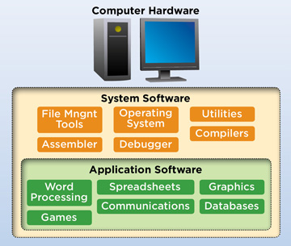
Software
The term software refers to the set of instructions that directs the hardware to accomplish a task.
System Software
Application Software
Utility Software

Slide 6
System Software
Software that can control or maintain the operations of the computer and its devices.
System software can be categorized as:
Operating system
Utilities and drivers
Programming language

Slide 7
Operating system software
DOS
WIN-98
WIN-ME
WIN-XP
WIN-VISTA
WIN-7
WIN-8
WIN10

Slide 8
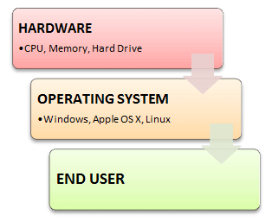
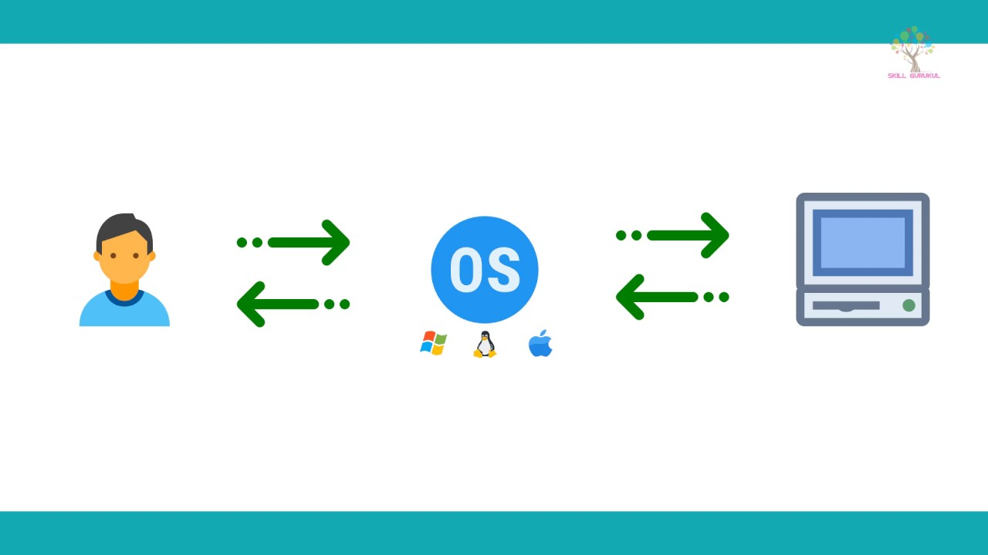
Operating system software

Slide 9
Utilities and Drivers
Utility Programs allow the user to perform maintenance-type tasks usually related to managing a computer, its devices or its programs.
Utilities provide file management capabilities such as copying, moving or renaming a file.
Drivers are usually used to allow some devices to communicate with the operating system
Utility Software is used to remove any problem or solve a complex situation in computer.
For example
Partition Magic Backup utility
Antivirus Data Recovery
Security Software Win Ghost

Slide 10
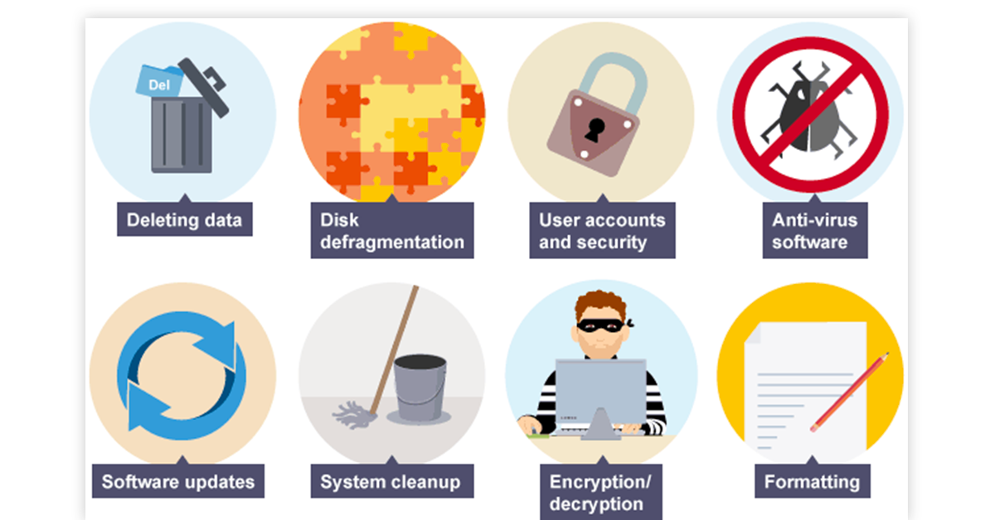
Utilities and Drivers

Slide 11
Programming Languages
Basic building blocks of any software.
Programming languages allow a programmer to write instructions that a computer can understand.
Programming languages have some resemblance to the English language.
Visual basic
Pascal
Fortran
C++
Java
Python

Slide 12
Application Software
Programs designed for user oriented tasks or for specific tasks.
Programs that work with operating system software to help the computer to do specific types of work.
Productivity Software
Spreadsheets
Databases
Presentation Software
Document Preparation
Word Processing
Desktop Publishing
Project Management Software
Graphics Creation and Manipulation
Video Editing
Internet Connectivity
Website Creation and Management
Financial Management
Educational Games and Tutorials

Slide 13
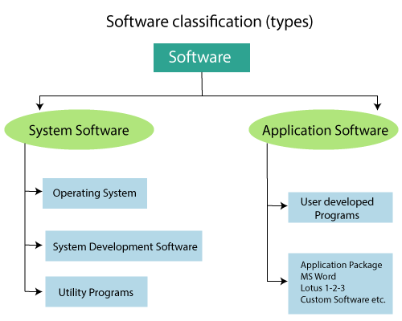
Application Software

Slide 14
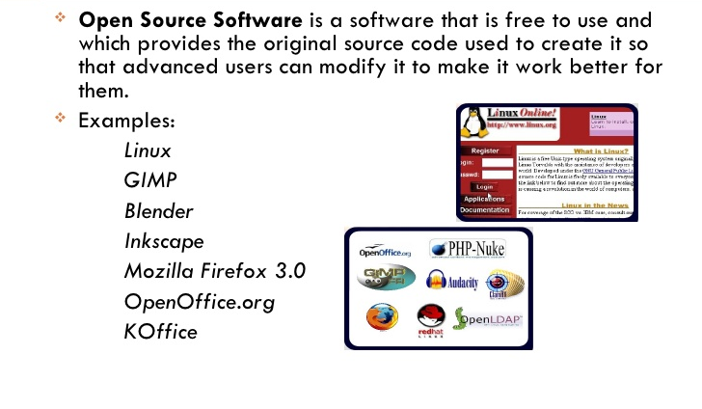
Open source and Proprietary Software

Slide 15
Thank You
NIELIT

